Slide 1

Image Captioning Bot
Major project Presentation
JAypee institute of information Technology
202
Under Supervisor : Dr. Kapil Dev Tyagi
Submitted by:
Shubham Gupta (9917102219)

Slide 2
PROBLEM STATEMENT
STATISTICS
OUR SOLUTION
HOW IT WORKS
DECISION-MAKING WORKFLOW
TRAINING & PREDICTION
MODEL DEPLOYMENT USING FLASK
SWOT ANALYSIS
POSSIBLE ADVANCEMENTS
REFERENCES
Contents

Slide 3
PROBLEM STATEMENT
01
AND MOTIVATION BEHIND THIS PROJECT.

Slide 4
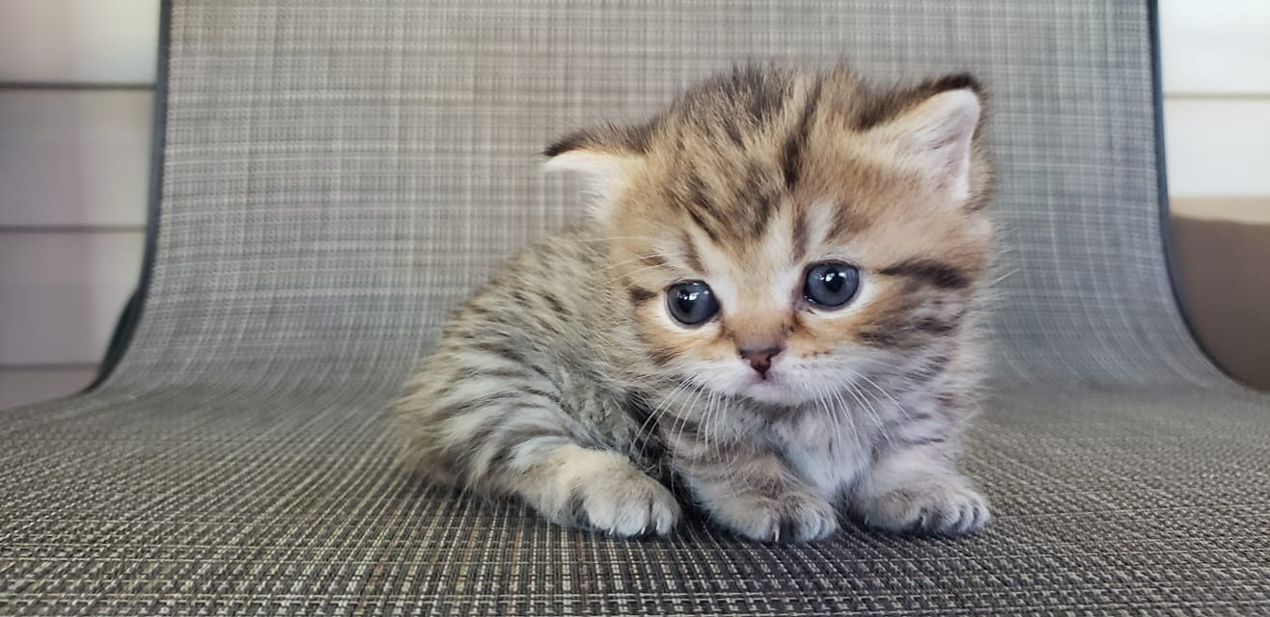
How will you describe this image ?

Slide 5
So, what we see in the picture?
Well some of us might say “A cat is sitting on mat”, some may say “Kitten with brown patches” and yet some others might say “Cute cat baby sat on mat”.
Definitely all of these captions are relevant for this image and there may be some others also.
It’s so easy for us, as human beings, to just have a glance at a picture and describe it.
Benefiting with the advances of image classification, it becomes possible to automatically generate one or more sentences to understand the visual content of an image, which is the problem known as Image Captioning.

Slide 6
In the current times, the most important thing is the massive data that exists on the Internet. Most of these data are different from traditional data, and media data occupies a large proportion. They are often generated from Internet products such as social networks or news media.
Apart from the fact that humans can directly process these media images, the machine can currently collect from them is limited and it is difficult to assist humans in further work.
Image captioning tasks, if they are accurate enough, can handle massive amounts of media data and generate human natural language descriptions that are more acceptable to humans.
The machine will be able to better assist human beings to use these media data to do more things.

Slide 7
We must understand how important this problem is to real world scenarios.
Let’s see few applications where a solution to this problem can be very useful.
Self driving cars — If we can properly caption the scene around the car, it can give a boost to the self driving system.
Aid to the blind — We can create a product for the blind which will guide them travelling on the roads without the support of anyone else
CCTV cameras — If we can also generate relevant captions, then we can raise alarms as soon as there is some malicious activity
Automatic Captioning — Can help, making Image Search as good as Google Search

Slide 8
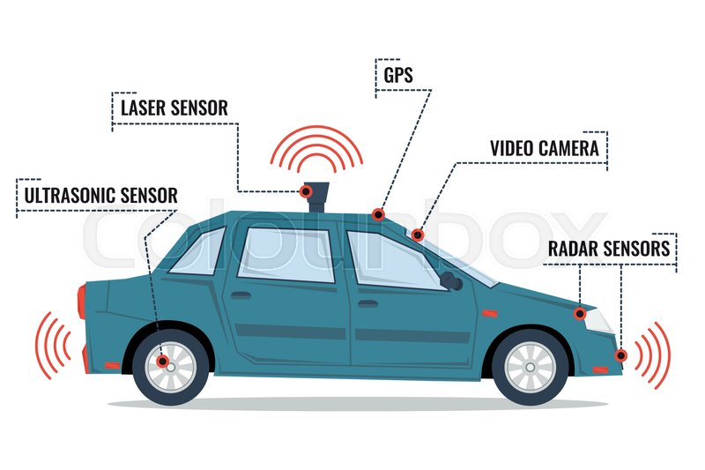
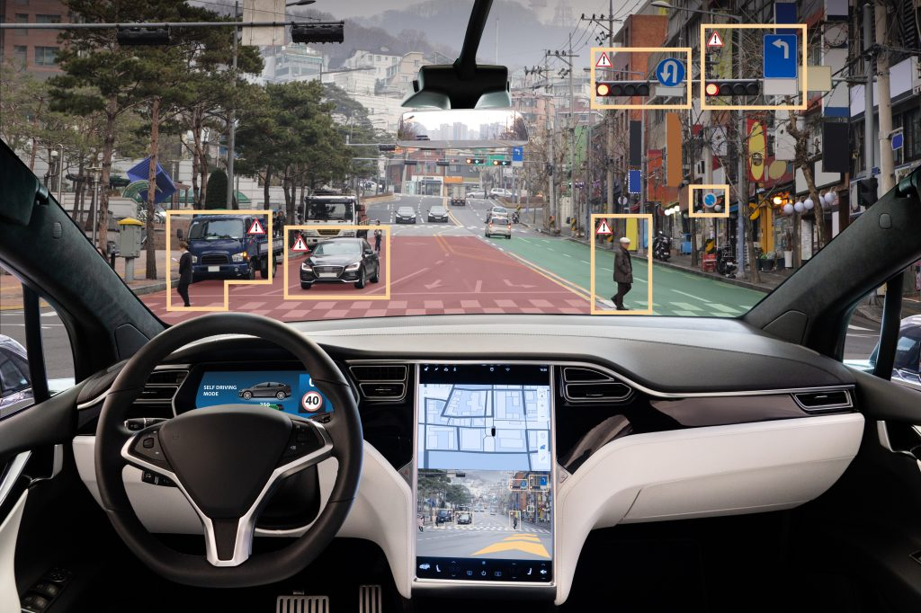

Slide 9
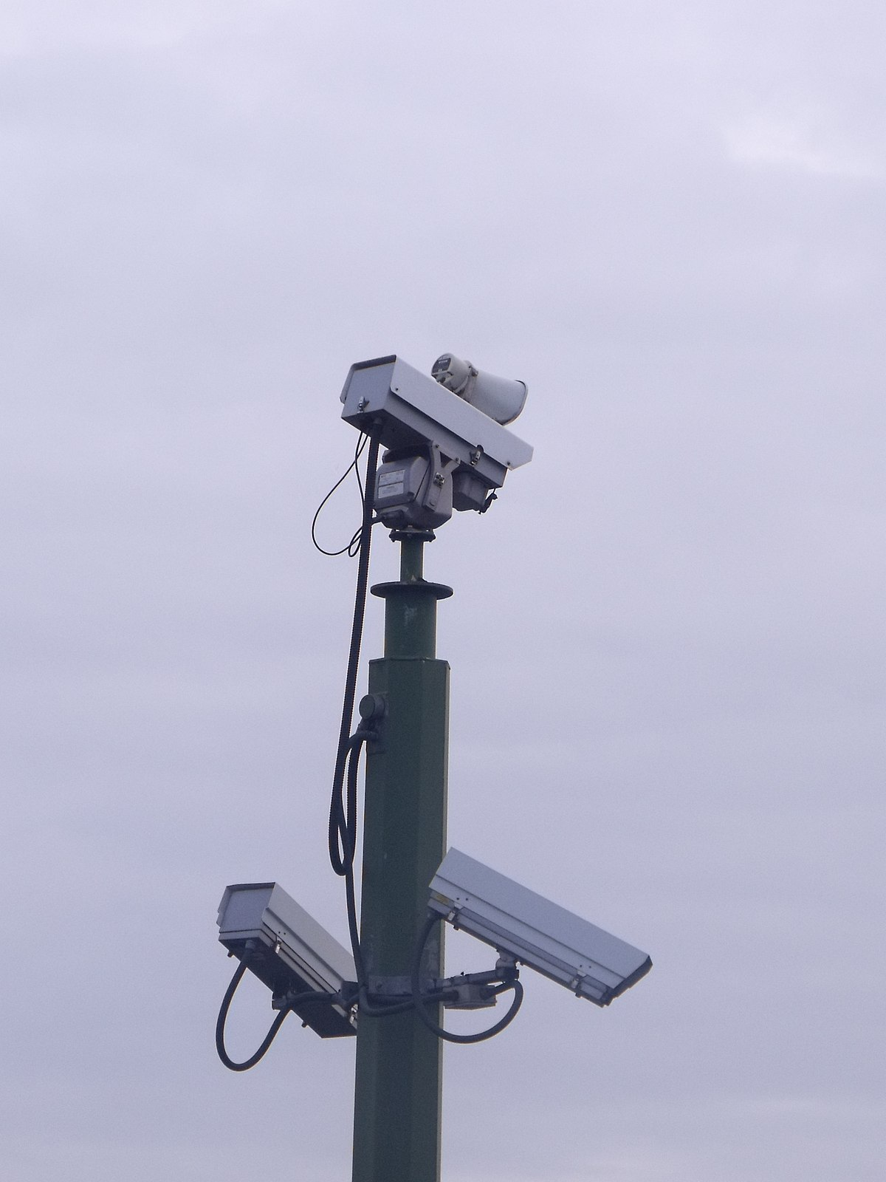
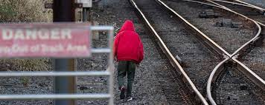
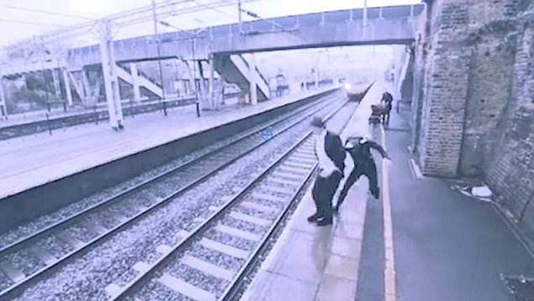
Generate caption and start playing siren that person is standing in dangerous area or doing unwanted things .
This all depends on different datasets fed to model to cover and predict on different situation
Person walking in prohibited area
................Starting Siren.................
Such captions will be generated to make sleeping security dept. employee aware
Person crossing yellow line
.............Starting Siren...........

Slide 10
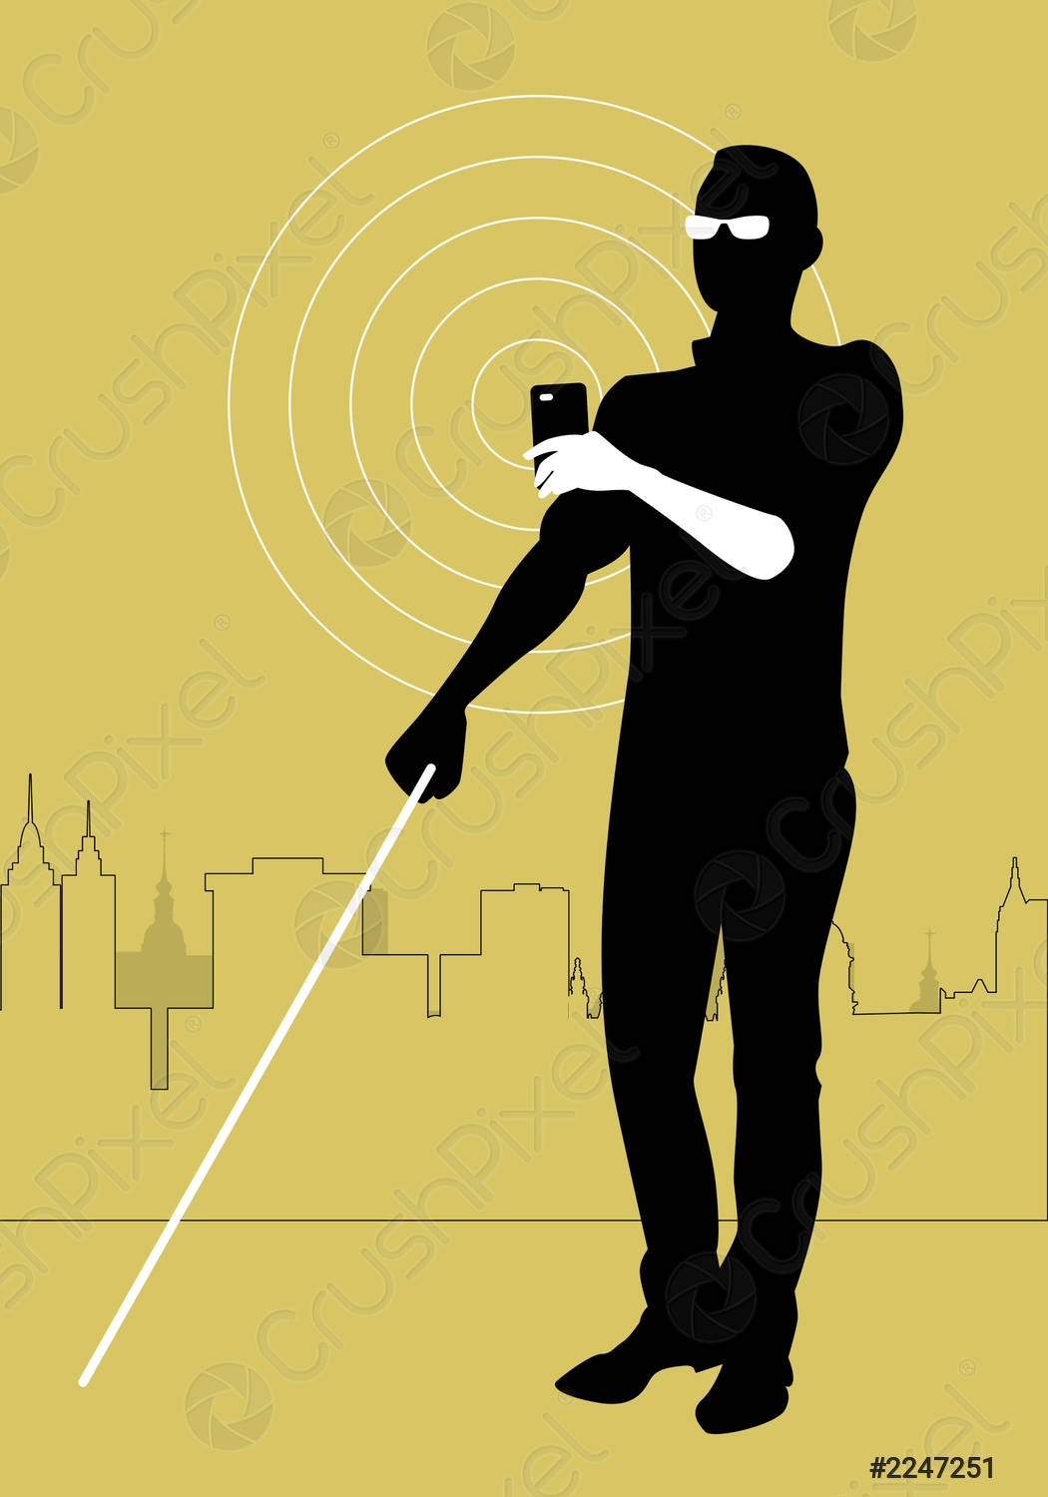
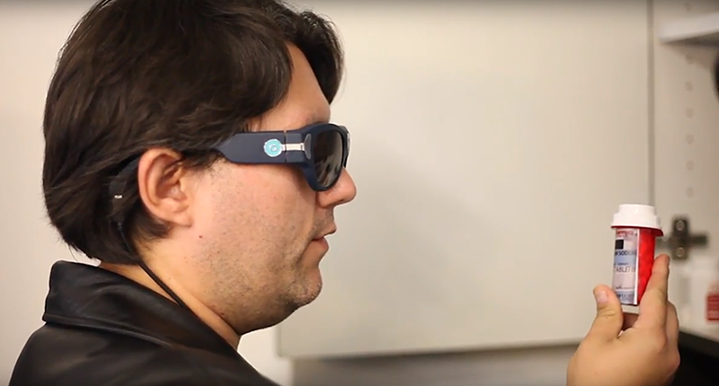
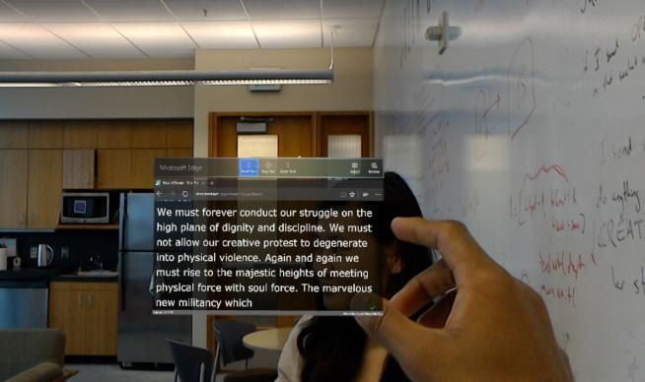
Whatever happening in front of blind person can be explained to him by caption generation. And then generated caption can be heard by blind person. Even we can add new thing for reading and orating text as well.

Slide 11
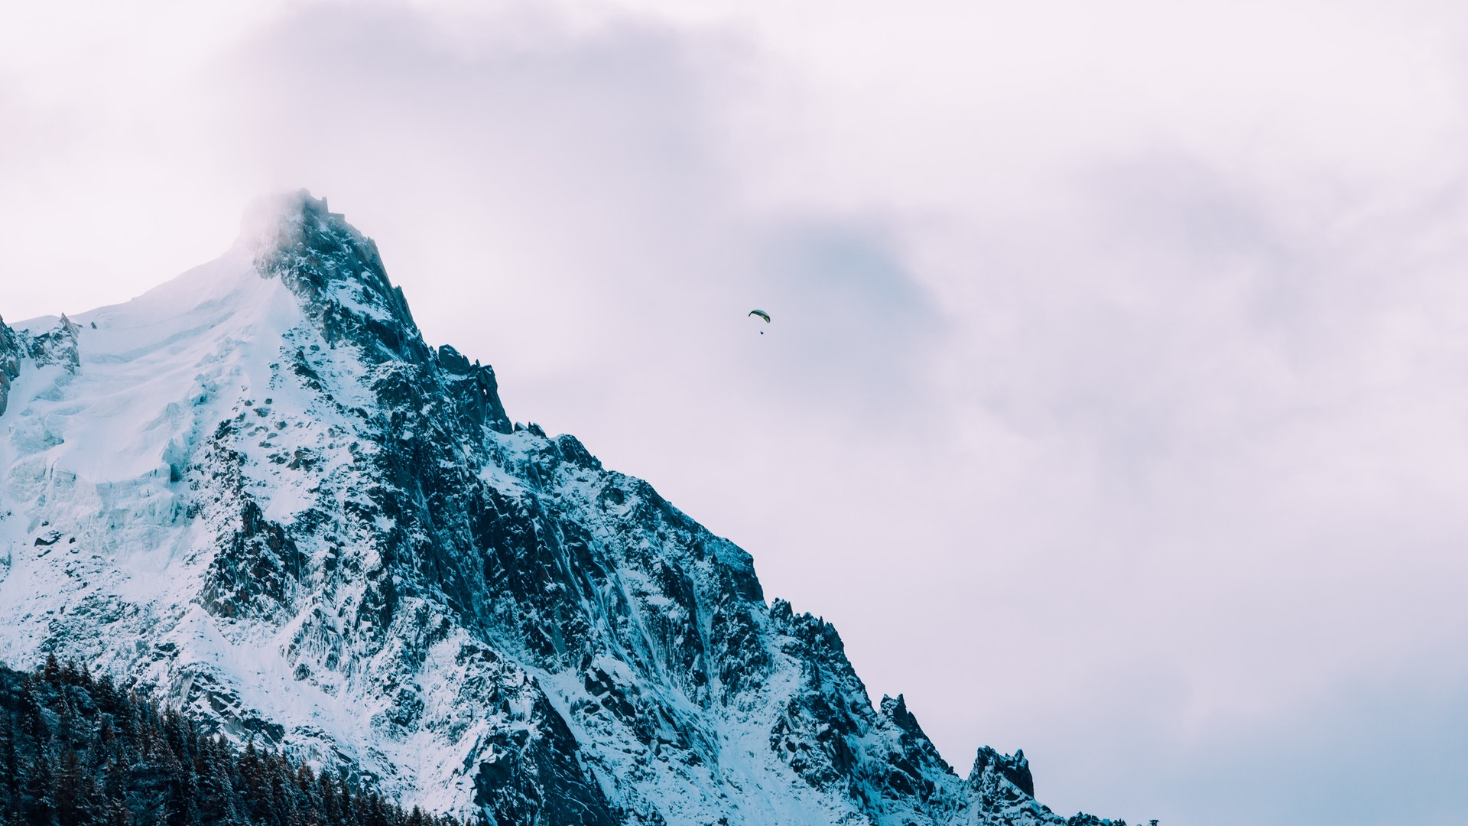
Source : Tensorflow Blog https://www.tensorflow.org/tutorials/text/image_captioning
02
STATISTICS
89%
89% accuracy achievement for first robot to receive Saudi arabian citizenship - Sophia, to detect the scenario and plattering the thoughts about it
Over 86% of car crashes are caused by driver error. There would be less user errors and fewer mistakes on the roads if all vehicles became driverless. Drunk and drugged drivers would also be a thing of the past, and passengers might even sleep without risking safety. And Driving fatigue and getting lost would be things of the past.
90
80
70
60
50
40
30
86%
With 84% of accuracy Mars Exploration Rover on can detect the weather and climatic situation.
Also with almost same accuracy +<5,it can detect the metal, non-metals, minerals present on the surface of mars
84%
This is the data for 2016-2019

Slide 12
HOW IT WORKS
03

Slide 13
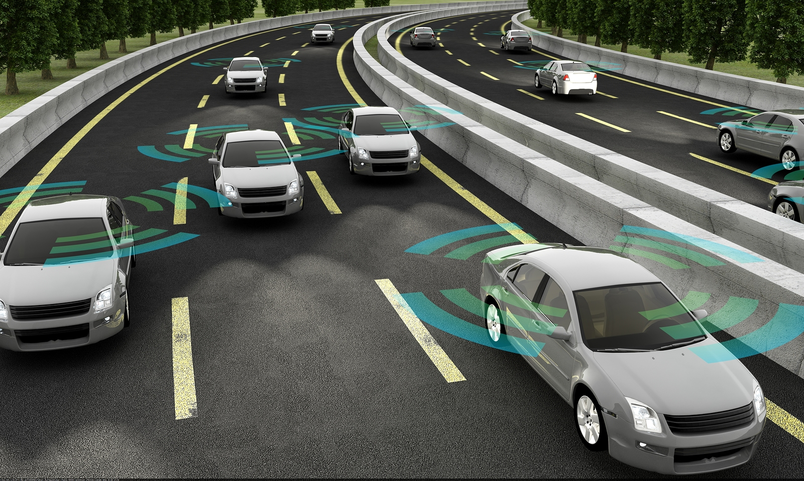
Conceptual Approach to Solve Problem
We implemented a deep recurrent architecture that automatically produces a short description of images. Our models use a CNN, which was pre-trained on ImageNet, to obtain images features. We then feed these features into a LSTM network to generate a description of the image in valid English language.
Feature Extraction using CNN
After feature extraction process we come towards Reccurent Neural Network where we will use embedding matrix LSTM and glove vector.
Then we will use Google's Pre Trained model i.e. Resnet-50 (Imagenet).
In next slide you can see how embedding is done followed by workflow diagram.

Slide 14
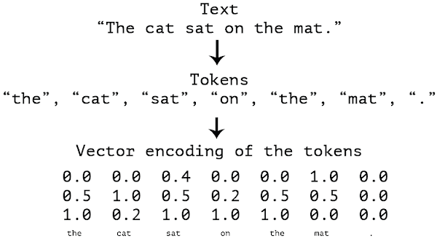

Slide 15
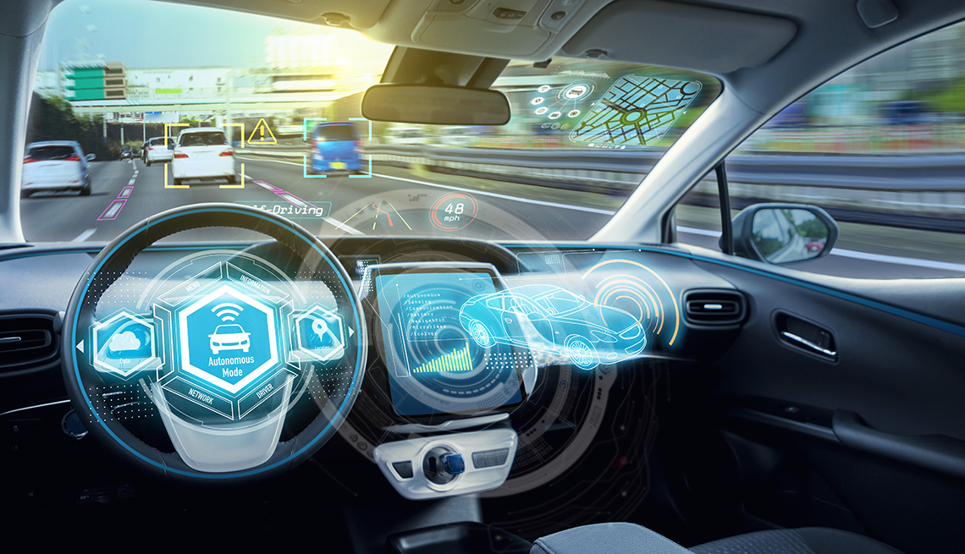
Steps that we followed:
Data collection and Understanding the data
Data Cleaning
Loading the training set
Data Preprocessing — Images
Data Preprocessing — Captions
Data Preparation using Generator Function
Use of Word Embeddings - Glove Vector
Model Architecture: Weights of the model will be updated through backpropagation algorithm and the model will learn to output a word, given an image feature vector and a partial caption.
Training
Prediction

Slide 16
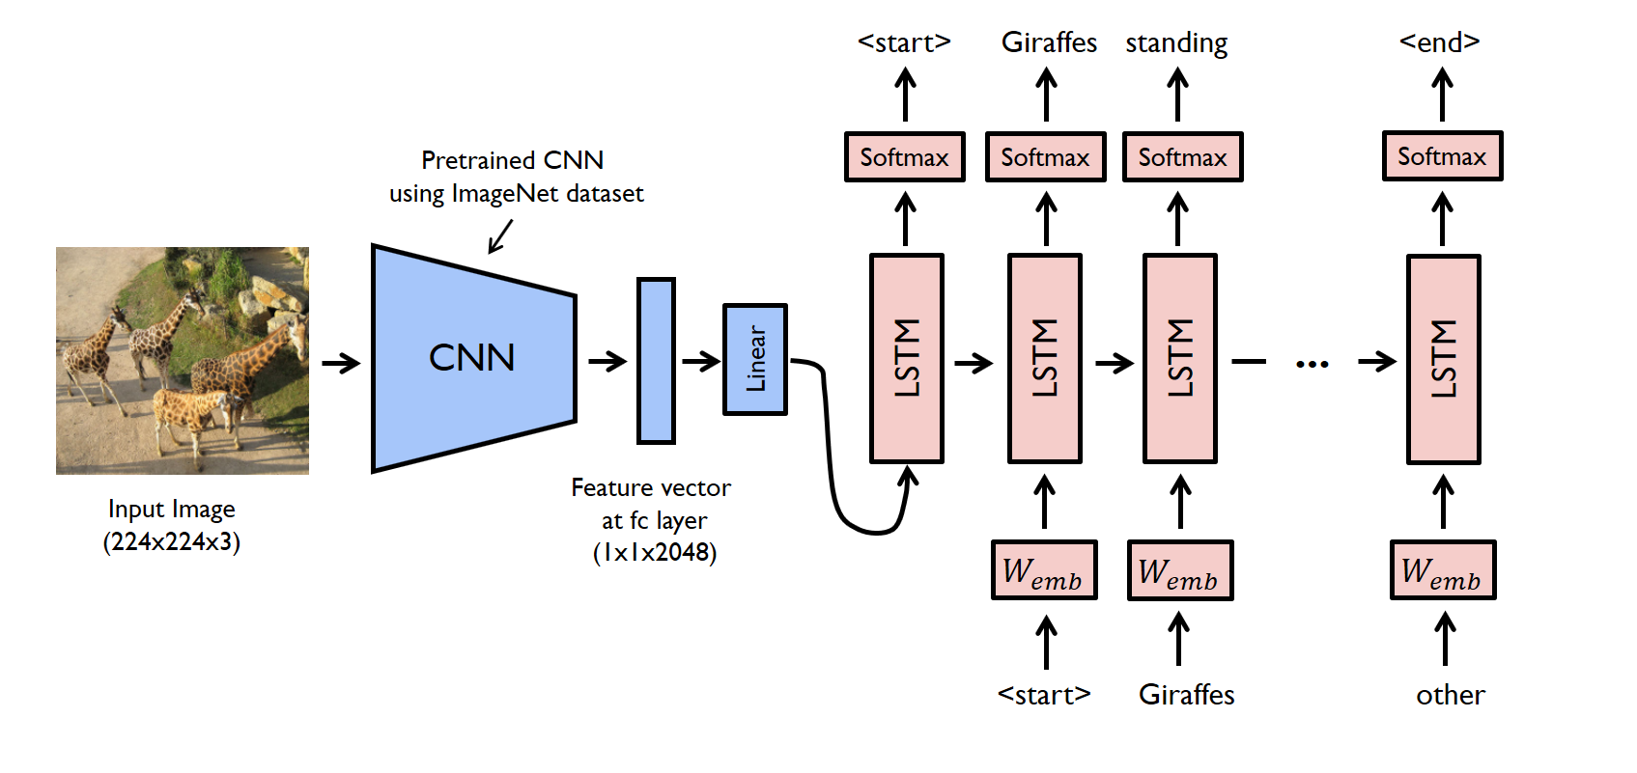
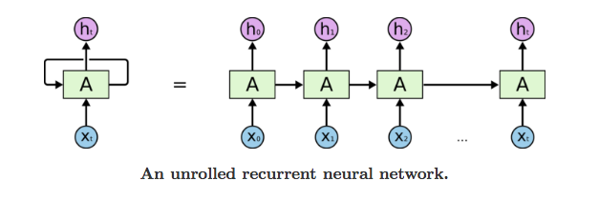
04 DECISION-MAKING WORKFLOW

Slide 17
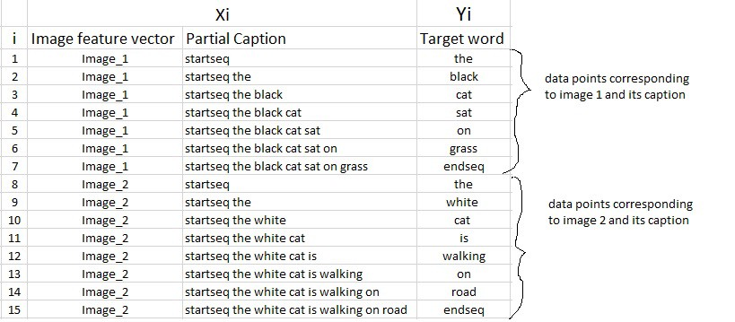
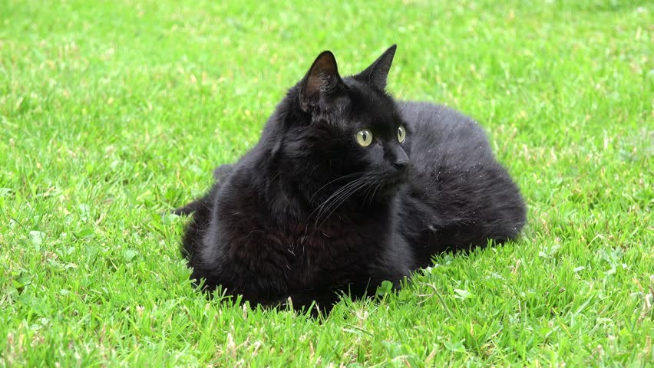
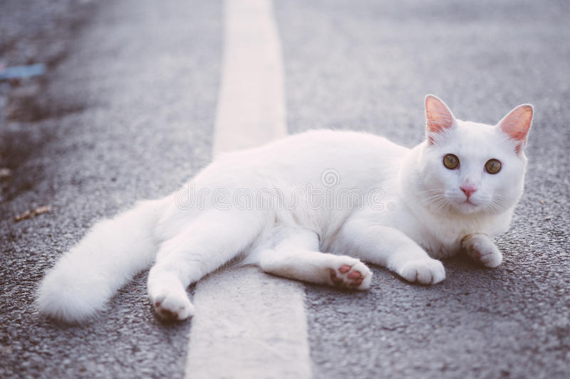
Training & Predictions

Slide 18
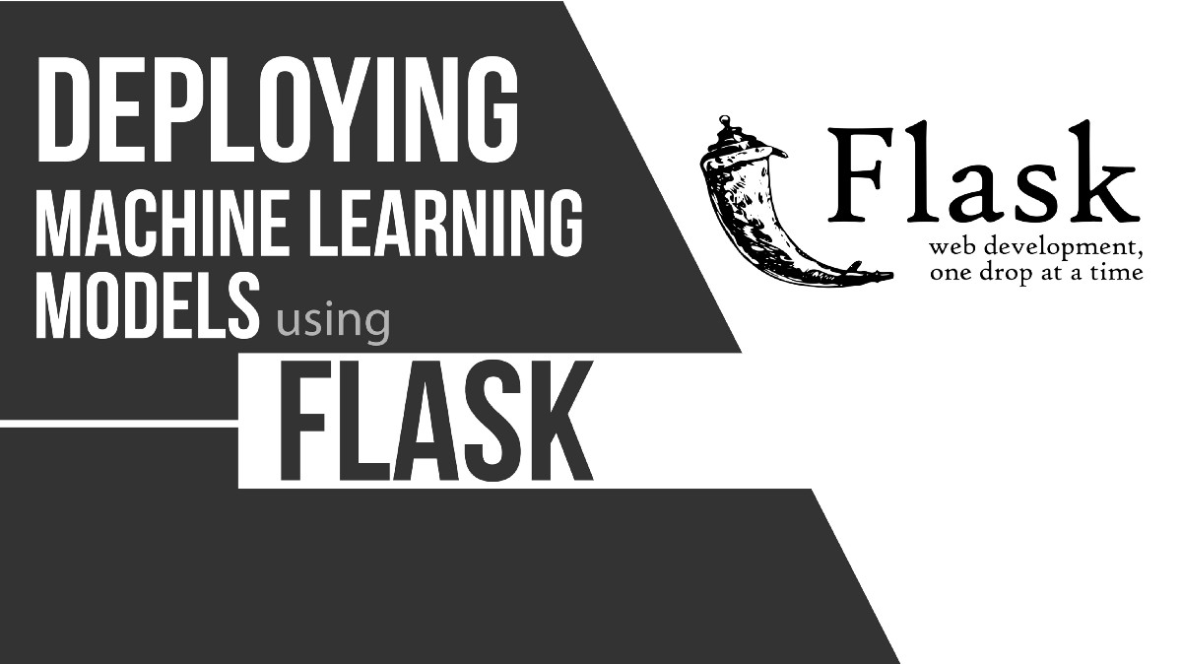

Slide 19
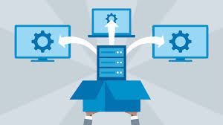
After all this we need to get this model web ready so that anyone can upload his or her image and get desired computerized caption for the image. We used HTML/CSS, Bootstrap and flask and convert this model into Web-API.
What is Model Deployment?
In a typical machine learning and deep learning project, we usually start by defining the problem statement followed by data collection and preparation, understanding of the data, and model building. But, in the end, we want our model to be available for the end-users so that they can make use of it.
Model Deployment is one of the last stages of any machine learning project and can be a little tricky.
How do you get your machine learning model to your client/stakeholder? What are the different things you need to take care of when putting your model into production?

Slide 20
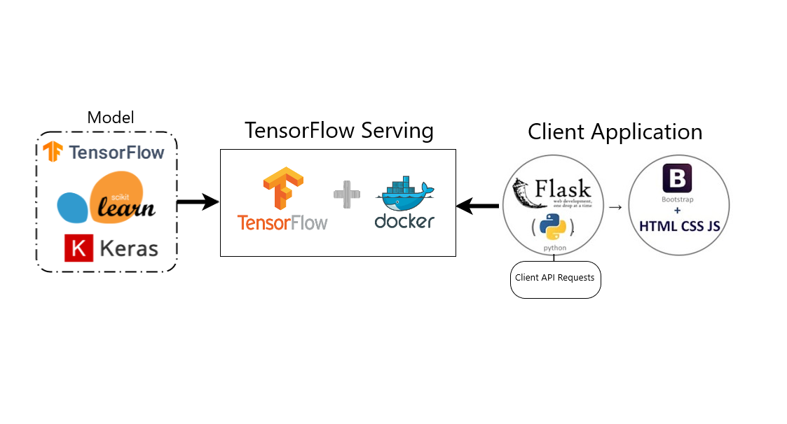

Slide 21
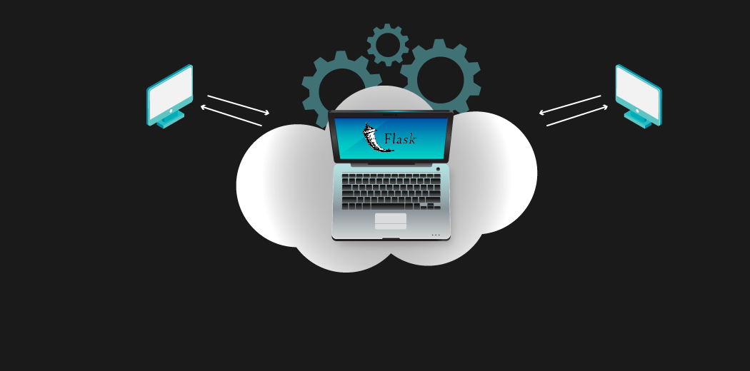
What is Flask?
Flask is a web application framework written in Python. It has multiple modules that make it easier for a web developer to write applications without having to worry about the details like protocol management, thread management, etc.
Flask gives us a variety of choices for developing web applications and it gives us the necessary tools and libraries that allow us to build a web application.
We will write code that will take care of the server side processing. Our code will receive requests. It will figure out what those requests are dealing with and what they are asking. It will also figure out what response to send to the user.

Slide 22
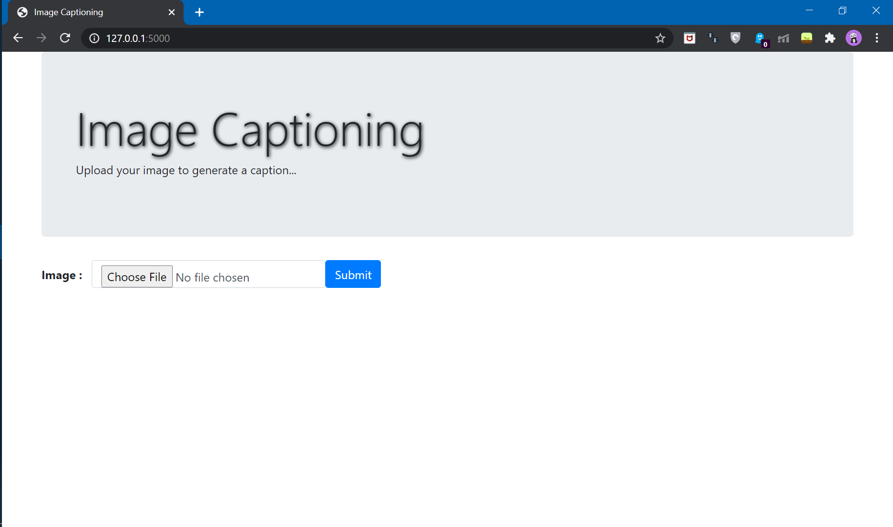
This is how API will Work
At first it will ask for image to be uploaded so that a caption can be generated

Slide 23
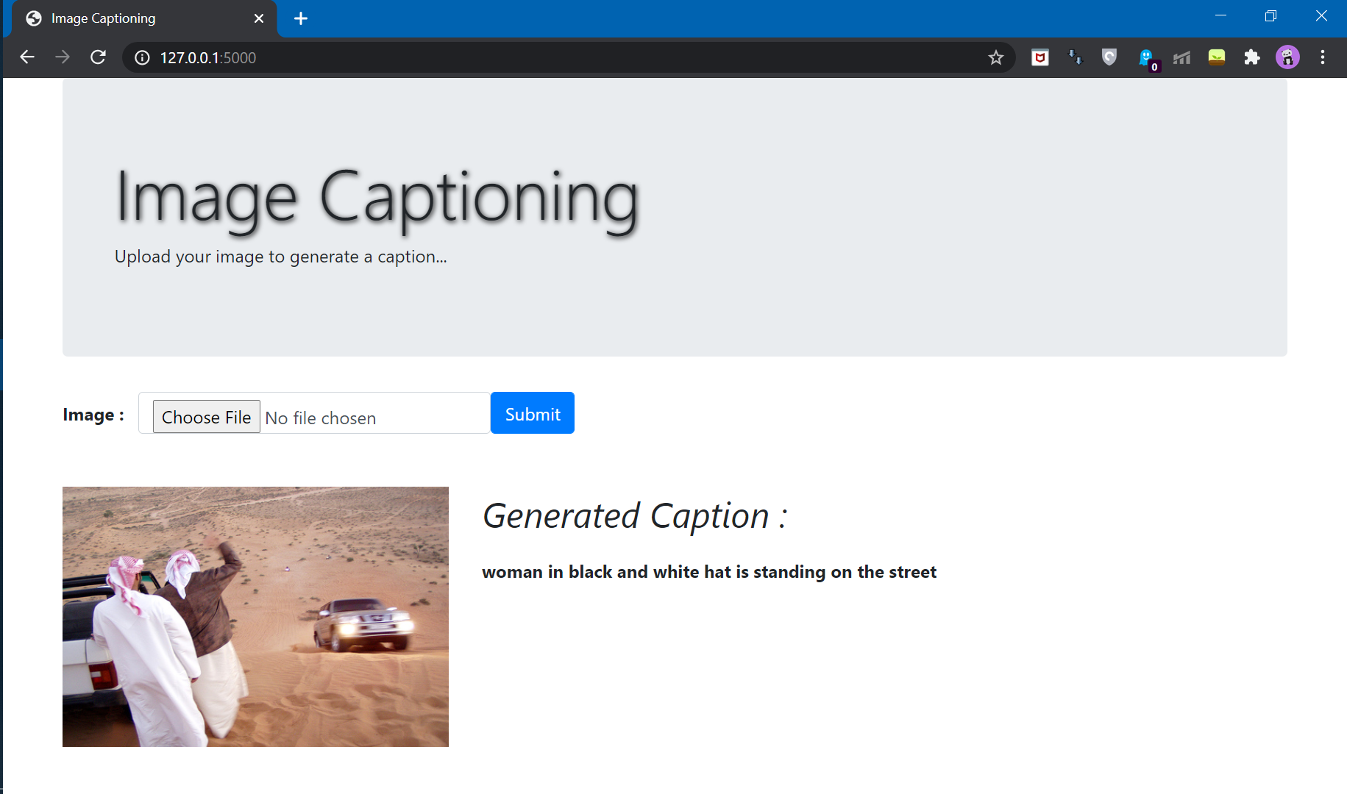
After uploading of image , our local server work on our local port available in our system and image will be sent for preprocessing.
After preprocessing image will be passed through Trained and Updated weights which will help in generation of Caption for the image as you can see in image.

Slide 24
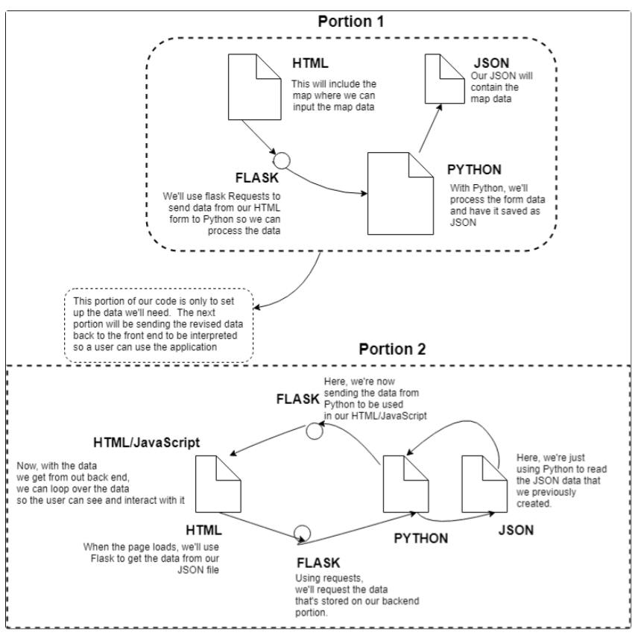

Slide 25

05
Swot Analysis
Strength
Weakness
The strength of the method is on its end-to-end learning framework.
Also Model can generate sentences with correct preposition and conjuctions
Training of Data require High Computation which is challenging and can be very expensive affair.
S
W
O
T
Opportunity
Threat
This project open various opportunities like Automated Vehicles, Robotic emotion Development.
The limitations in achieving accuracy might pose major threat but it can be coverd by using new and good pretrained models

Slide 26
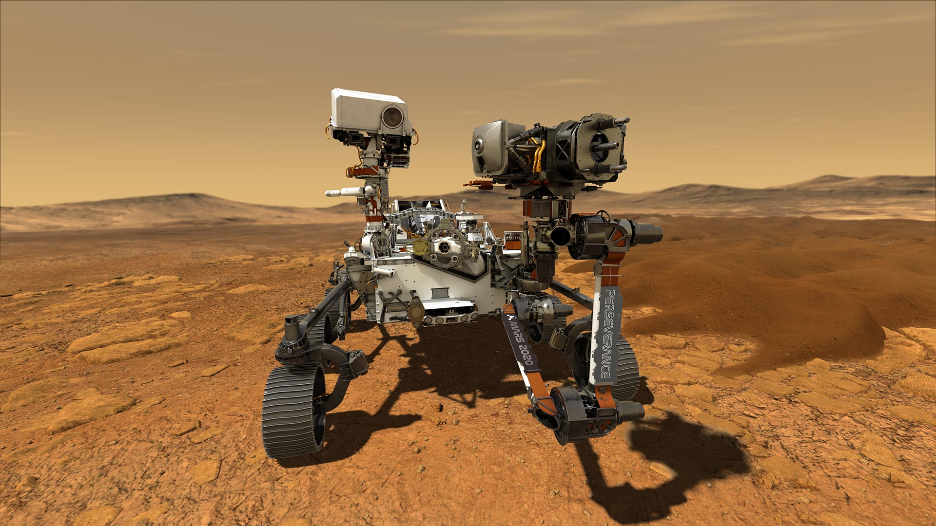
06 POSSIBLE ADVANCEMENTS
Using a larger dataset.
Doing more hyper parameter tuning (learning rate, batch size, number of layers, number of units, dropout rate, batch normalization etc.).
Use the cross validation set to overcome Overfitting.
Using BLEU Score to evaluate and measure the performance of the model. If needed, the performance can be improved.
We have allready make our API ready to be deployed. We can take our image captioning bot on Cloud but somehow Cloud Pricing is too high for student to match.

Slide 27
REFERENCES
07
[Jia et al.2014] Yangqing Jia, Evan Shelhamer, Jeff Don_x0002_ahue, Sergey Karayev, Jonathan Long, Ross Girshick,Sergio Guadarrama, and Trevor Darrell. 2014. Caffe: Convolutional architecture for fast feature embedding. In Proceedings of the ACM International Conference on Multimedia, pages 675–678.
[Johnson et al.2016] Justin Johnson, Andrej Karpathy, and Li Fei-Fei. 2016. Densecap: Fully convolutional
localization networks for dense captioning. In IEEE CVPR.
[Jozefowicz et al.] Rafal Jozefowicz, Wojciech Zaremba, and Ilya Sutskever. An empirical exploration of recurrent network architectures. In ICML.
[Karpathy and Fei-Fei] Andrej Karpathy and Li Fei-Fei.Deep visual-semantic alignments for generating image descriptions. In IEEE CVPR.[1]
Mikolov, Tomas, Ilya Sutskever, Kai Chen, Greg S. Corrado, and Jeff Dean. ”Distributed representations of words and phrases and their compositionality.” Advances in Neural Information Processing Systems (NIPS)26: 3111–3119 (2013). Web. 29 Apr. 2016

Slide 28

THANK YOU

